Slide 1
Chapter 4
Circuit Theorems

Slide 2

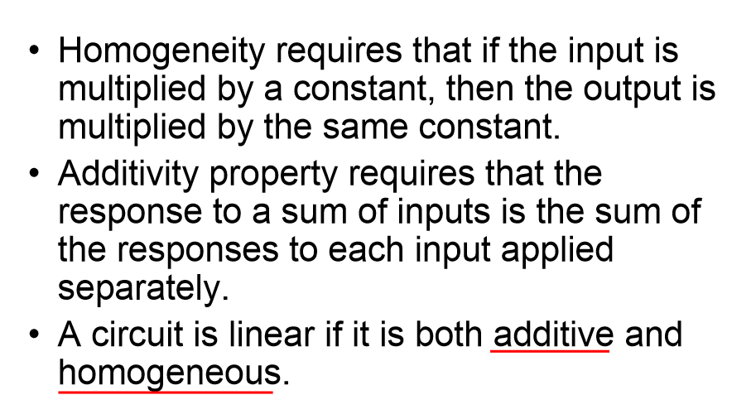

Slide 3
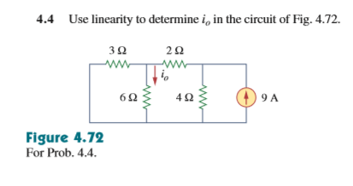

Slide 4
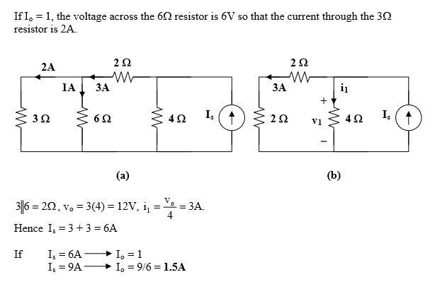

Slide 5

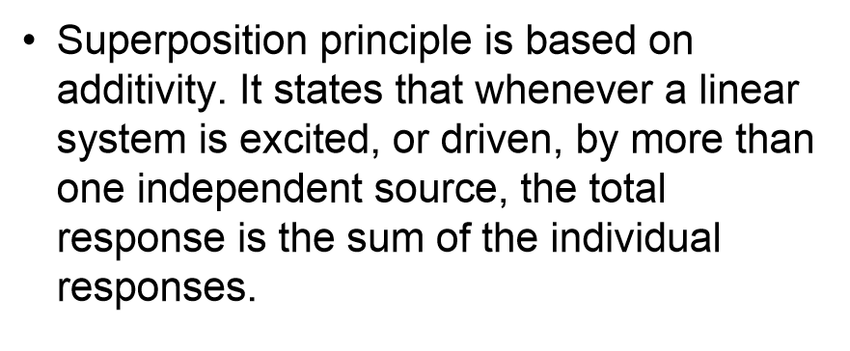
Respectively analyze the influence of each independent source

Slide 6
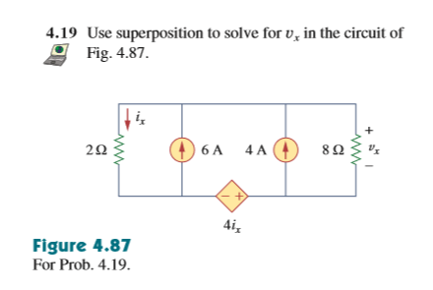

Slide 7
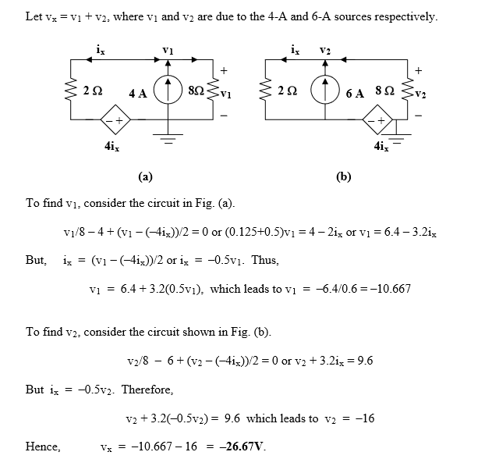
First check independent sources
Respectively calculate the results
Sum

Slide 8

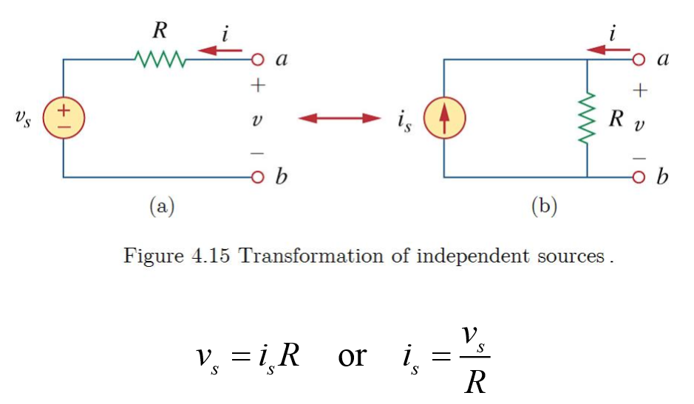
The same as the dependent sources
A useful tool to simplify the circuit

Slide 9
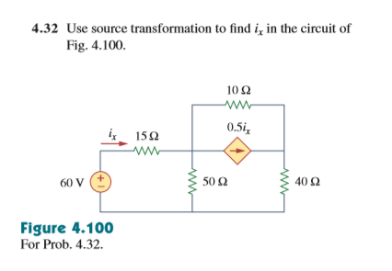

Slide 10
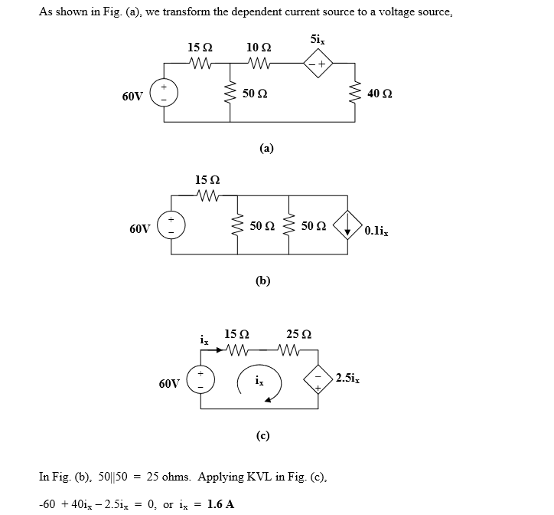
Simplify the circuit and use KCL/KVL to solve it
The principle is to make the calculation easier

Slide 11

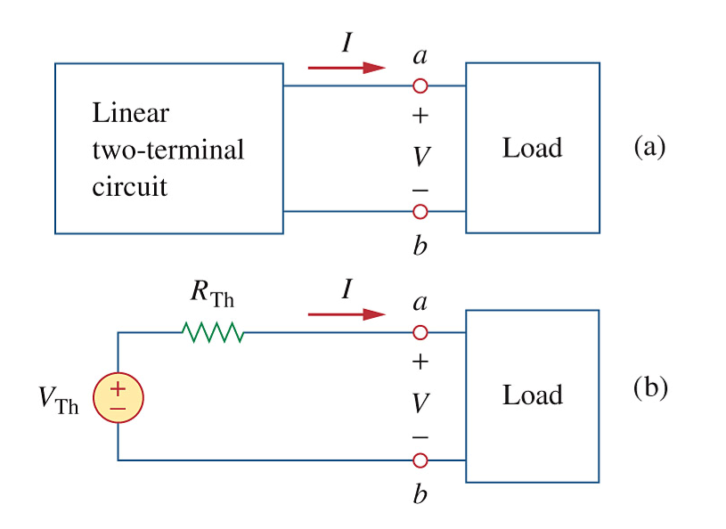
To calculate the replaced V and R when we connect the linear circuit with the load

Slide 12
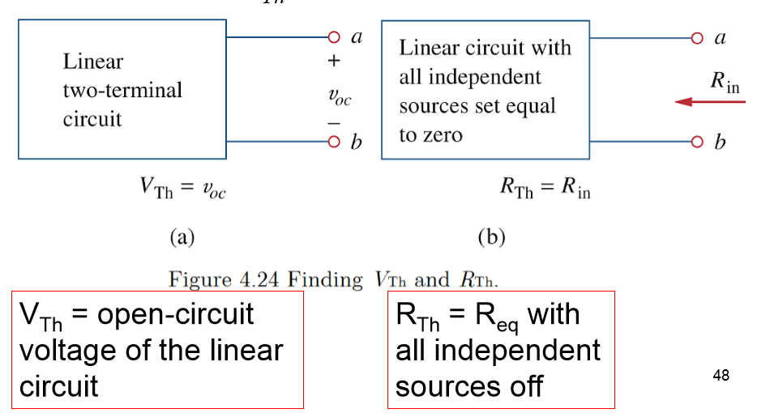
The method for the network has no dependent sources
Turn off all independent sources

Slide 13
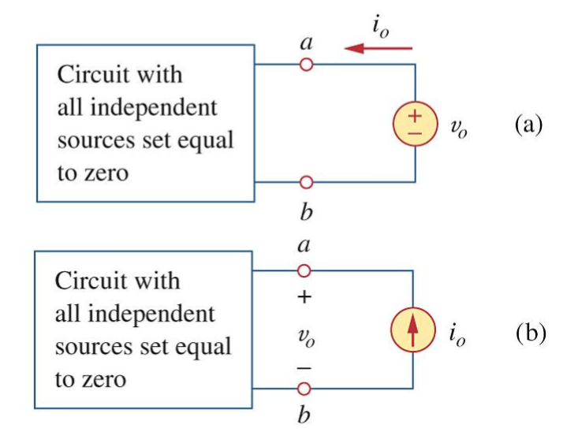

The method for the network has dependent sources
Turn off all independent sources, and apply a voltage source

Slide 14
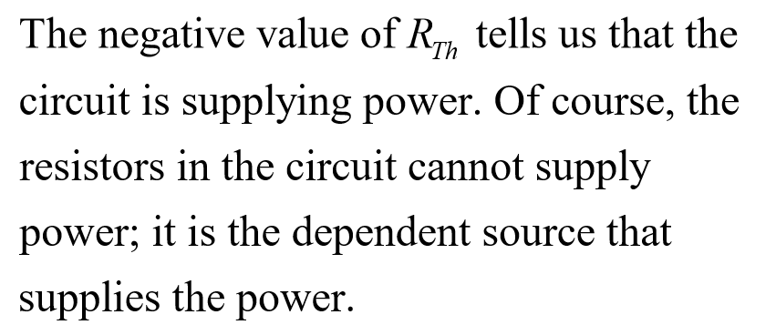
Don’t worry about the sign in your results. As mentioned before, the sign not only shows the value but also represent the direction or supply/absorb power.

Slide 15
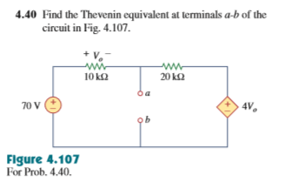

Slide 16
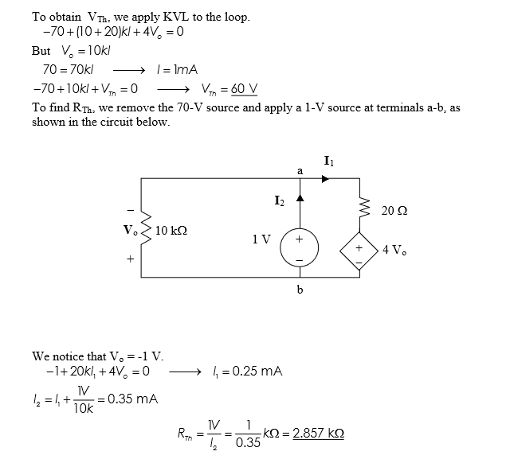

Slide 17

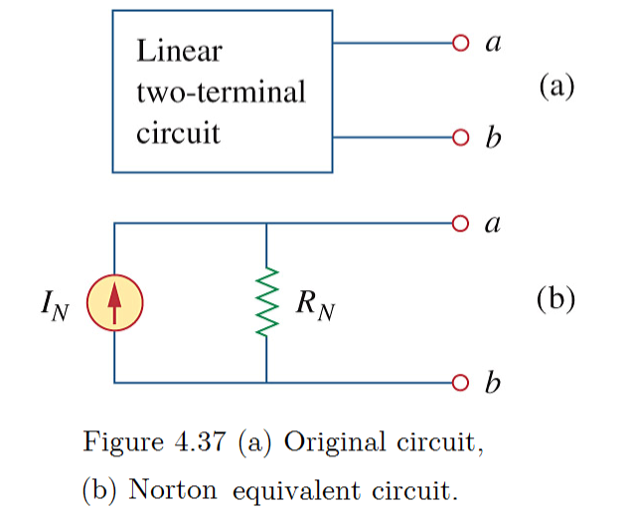
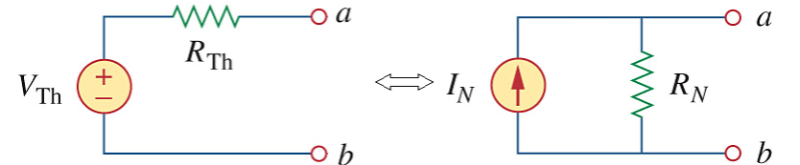
Similar as Thevenin’s theorem.
Use source transformation to change between two equivalent circuit.

Slide 18
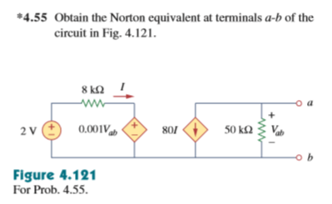

Slide 19
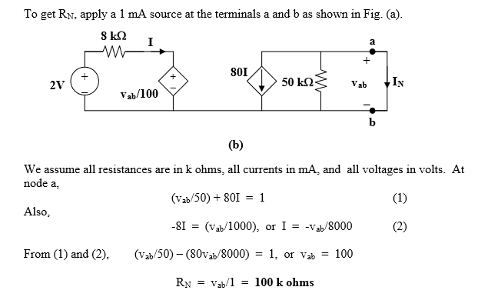

Slide 20
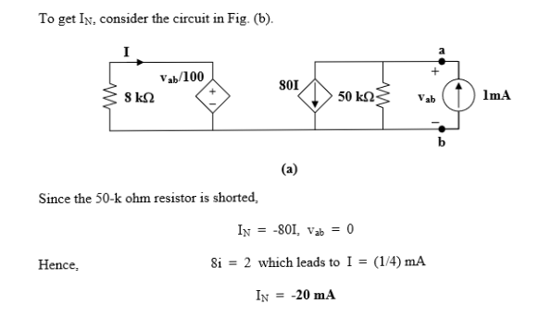

Slide 21
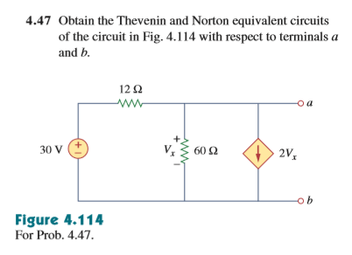

Slide 22
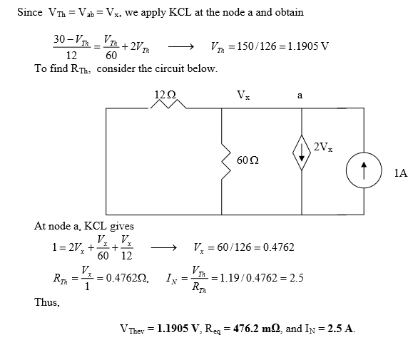

Slide 23



Provide power in highest ratio.
Provide power in biggest amount.

Slide 24
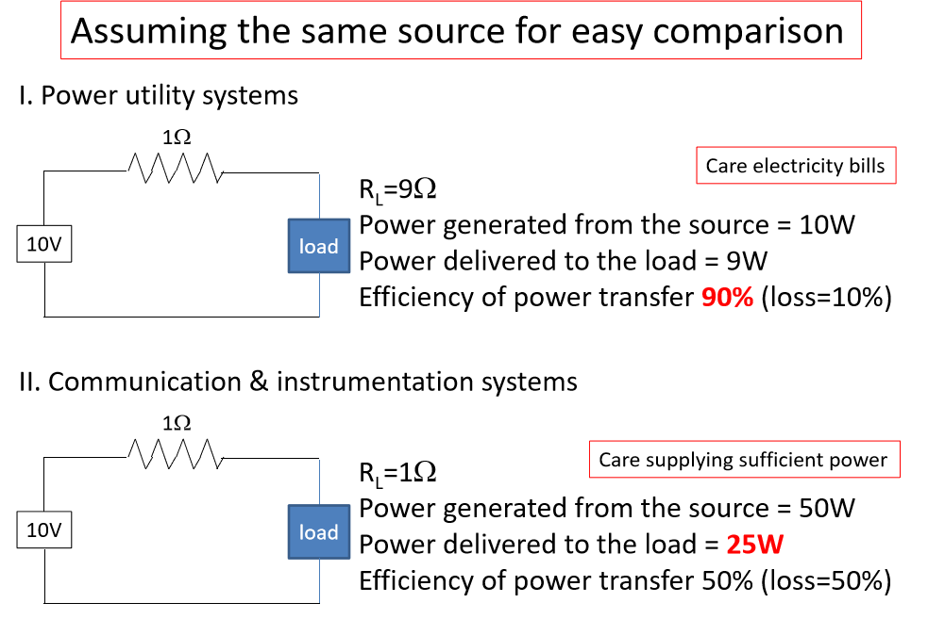

Slide 25
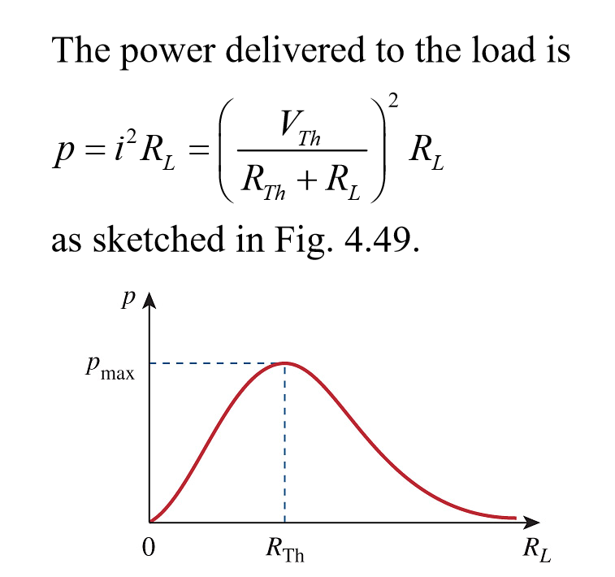

Slide 26
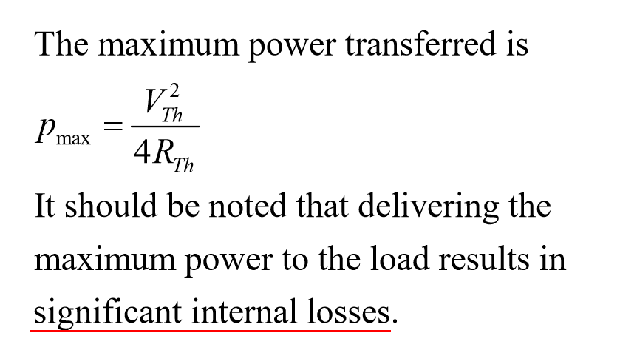

Slide 27
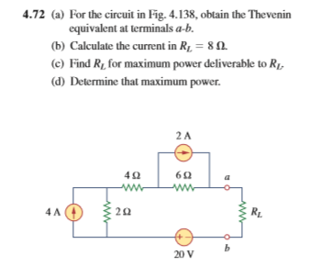

Slide 28
